Slide 1
GIT and GIT HUB

Slide 2
Steps
1: Install git and create a GitHub account
2: Create a new repository on GitHub
3: Open the path in command prompt
4: Git init (check in the folder where new file .git will be created automatically)
5: git add .
6: git commit –m “commit”
7: git status
8: git branch
9: git remote add origin https://github.com/Supriya-Pothuraju/ustdemos.git
10: git push –u origin master

Slide 3
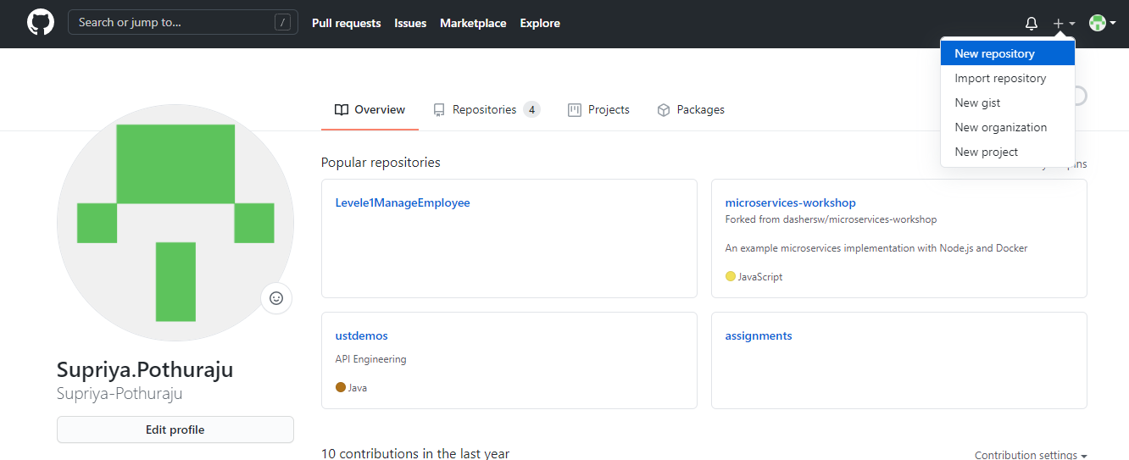
Create New repository

Slide 4
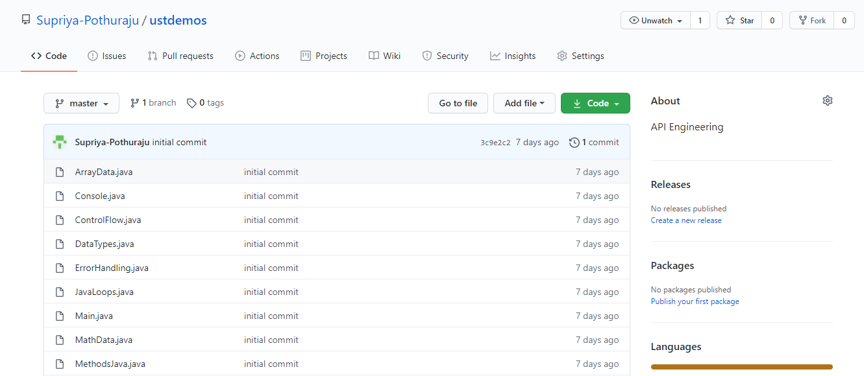
View files

Slide 5
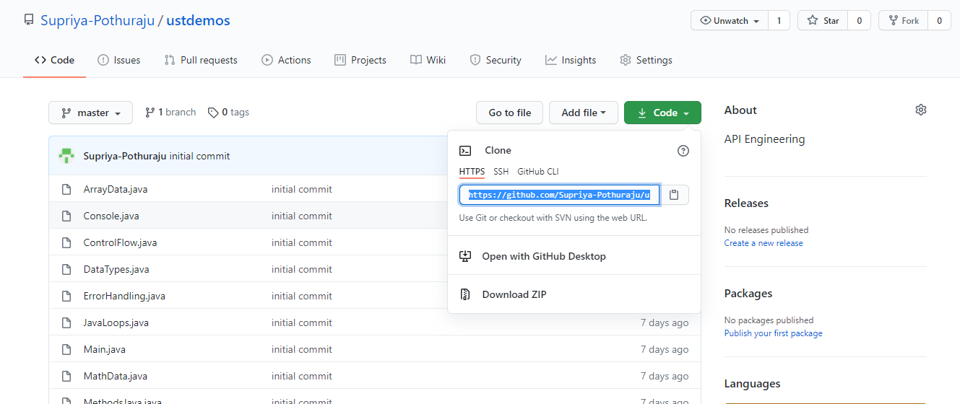
Link

